Slide 1
Outline
DISTINCT Clause
AND, OR, NOT Operator
IN, NOT IN operator
BETWEEN, NOT BETWEEN Operator
LIKE Operator (With WILDCARDS)

Slide 2
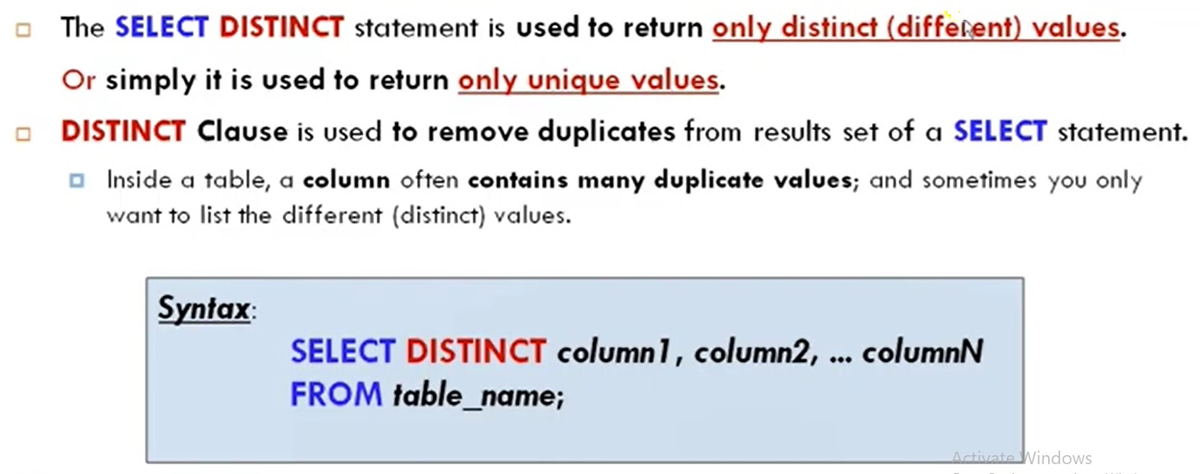
SELECT DISTINCT : “DISTINCT Clause”

Slide 3
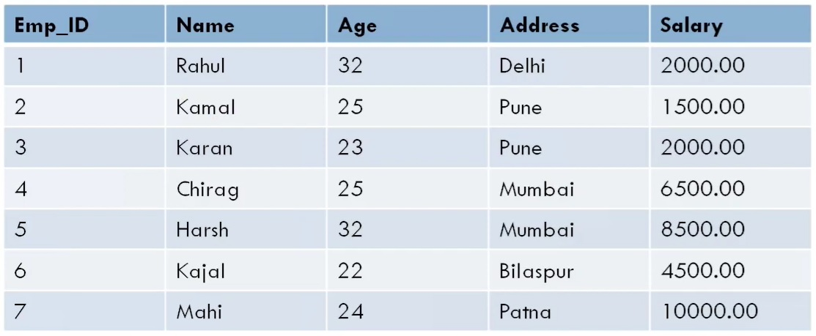
Example

Slide 4
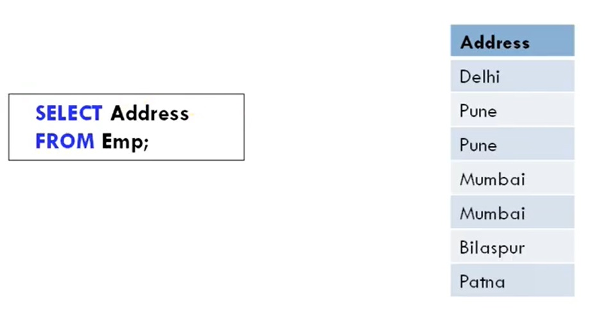
SELECT without DISTINCT

Slide 5
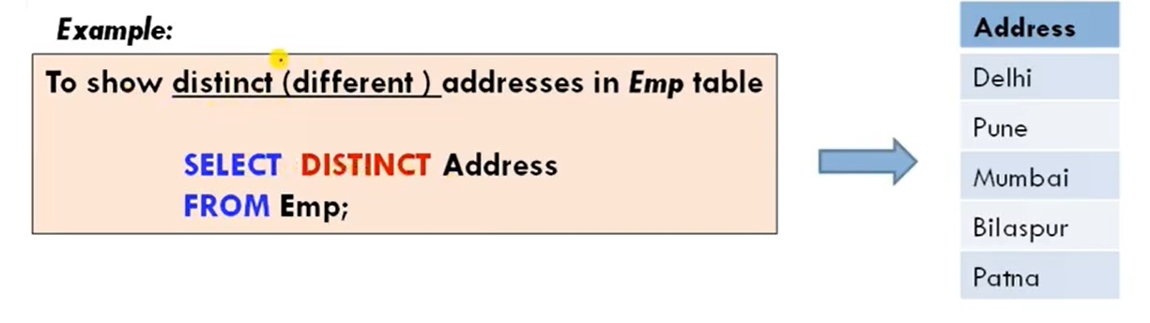
SELECT with DISTINCT

Slide 6
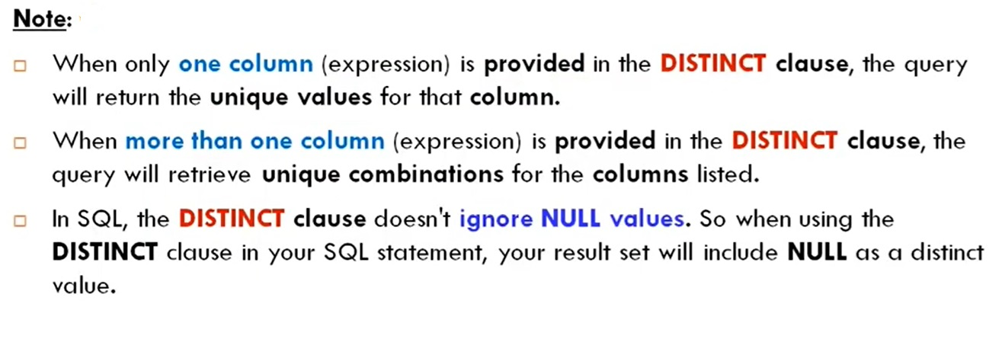
SELECT DISCTINCT cont…

Slide 7

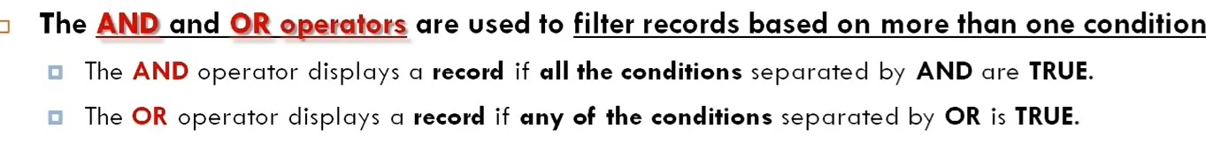

SQL : AND, OR, NOT Operator

Slide 8
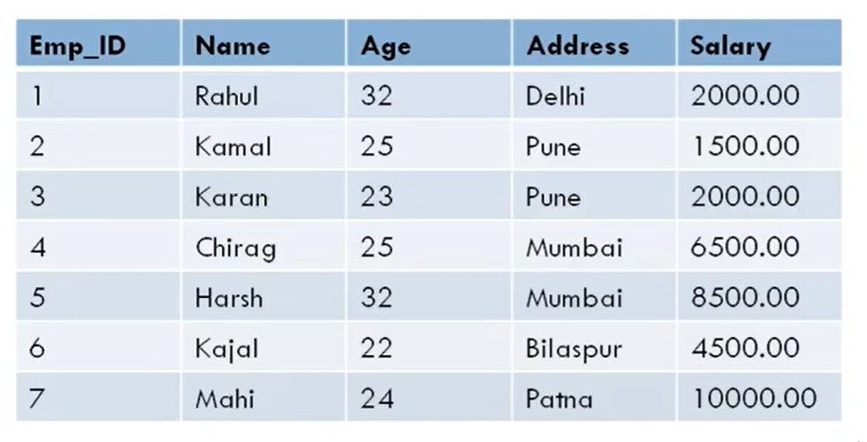
Example

Slide 9
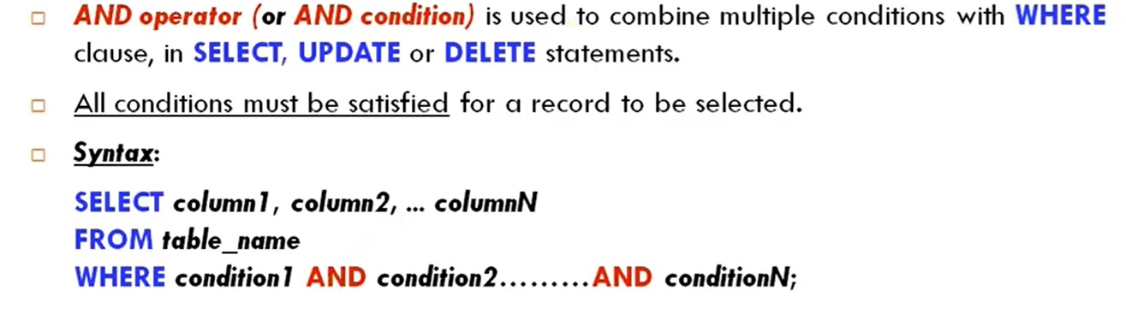
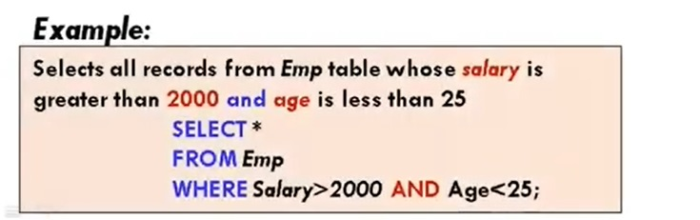
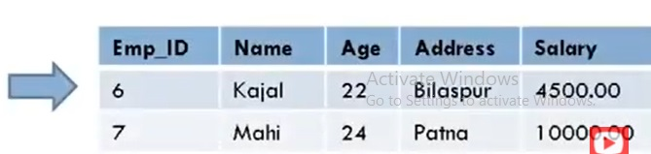
SQL : AND Operator

Slide 10
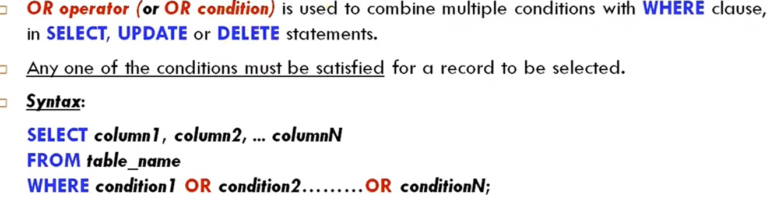
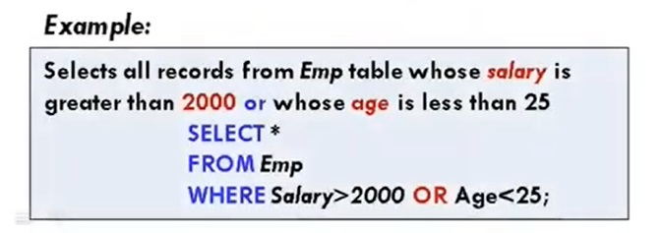
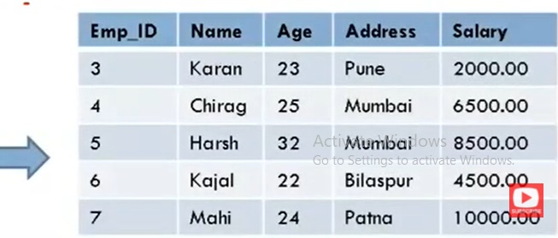
SQL : OR Operator

Slide 11
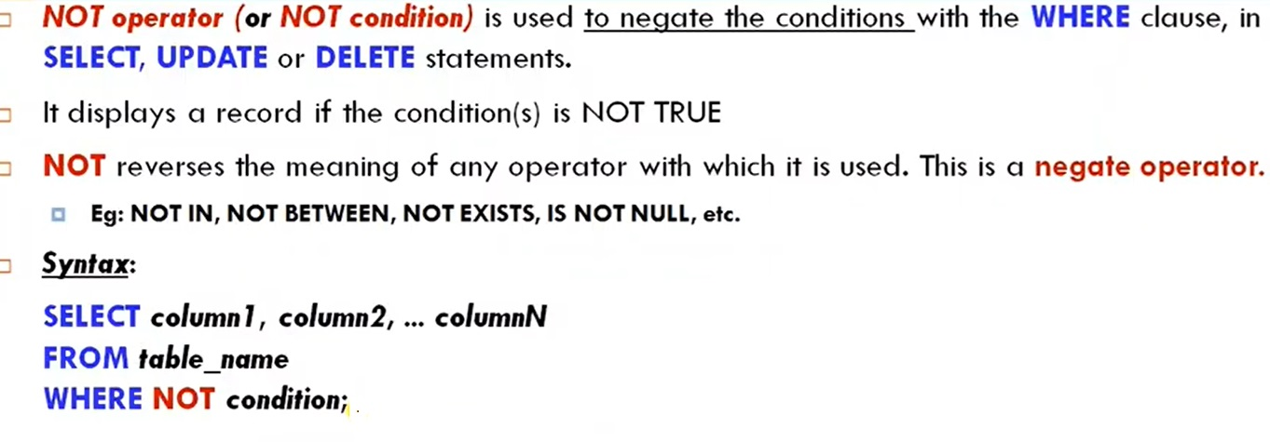
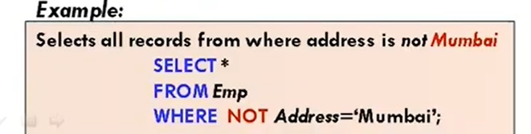
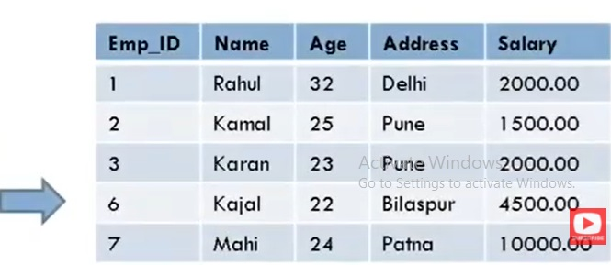
SQL : NOT Operator

Slide 12
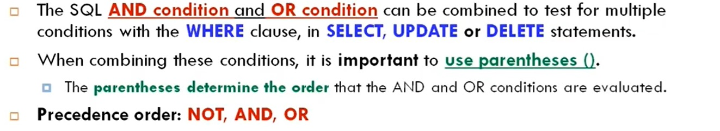
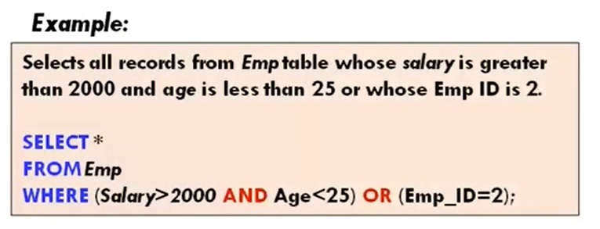
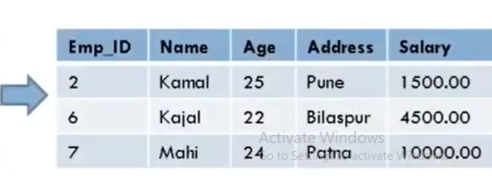
Example : Combining AND and OR Conditions

Slide 13
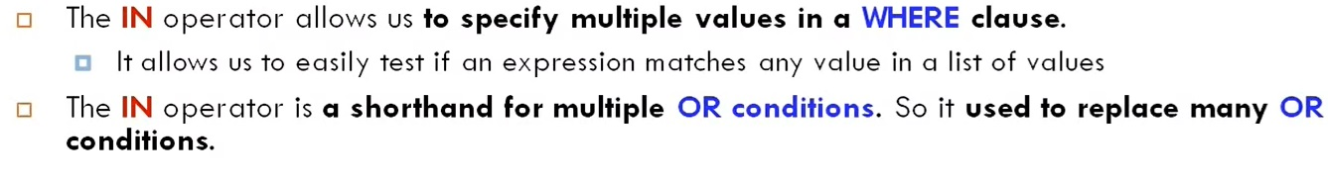
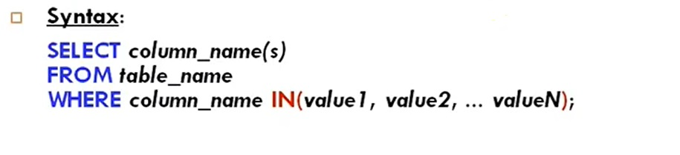
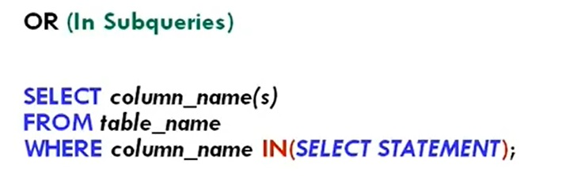
SQL IN Operator

Slide 14
Example

Slide 15
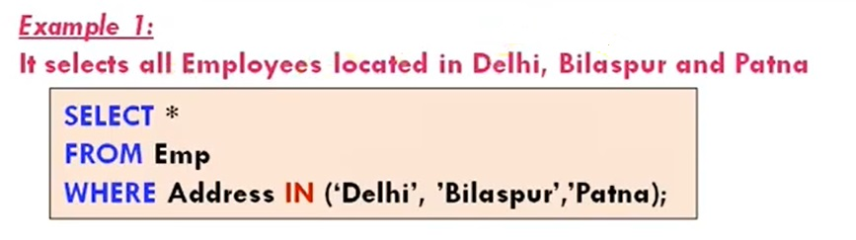
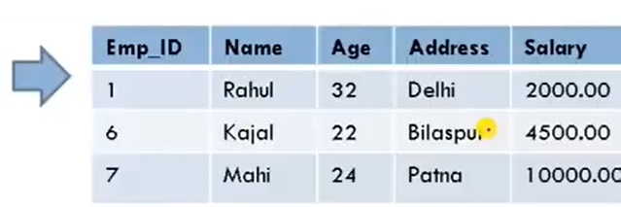
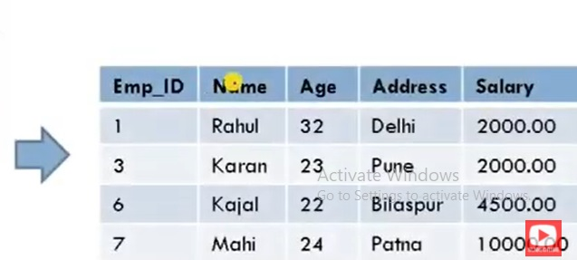
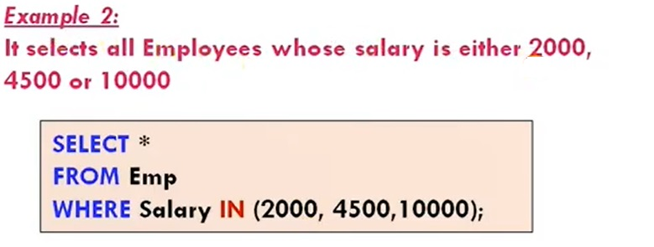
Example : IN Operator

Slide 16
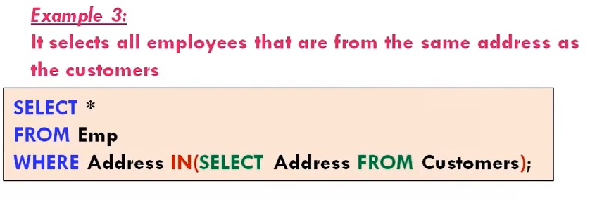
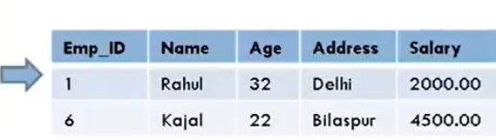
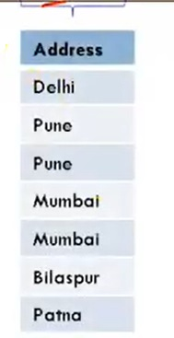
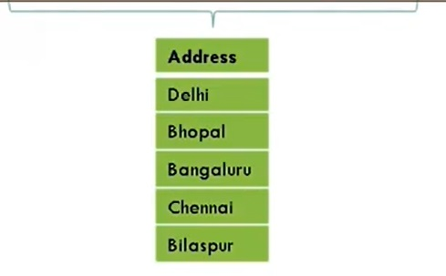
Example : IN operator using Subqueries

Slide 17
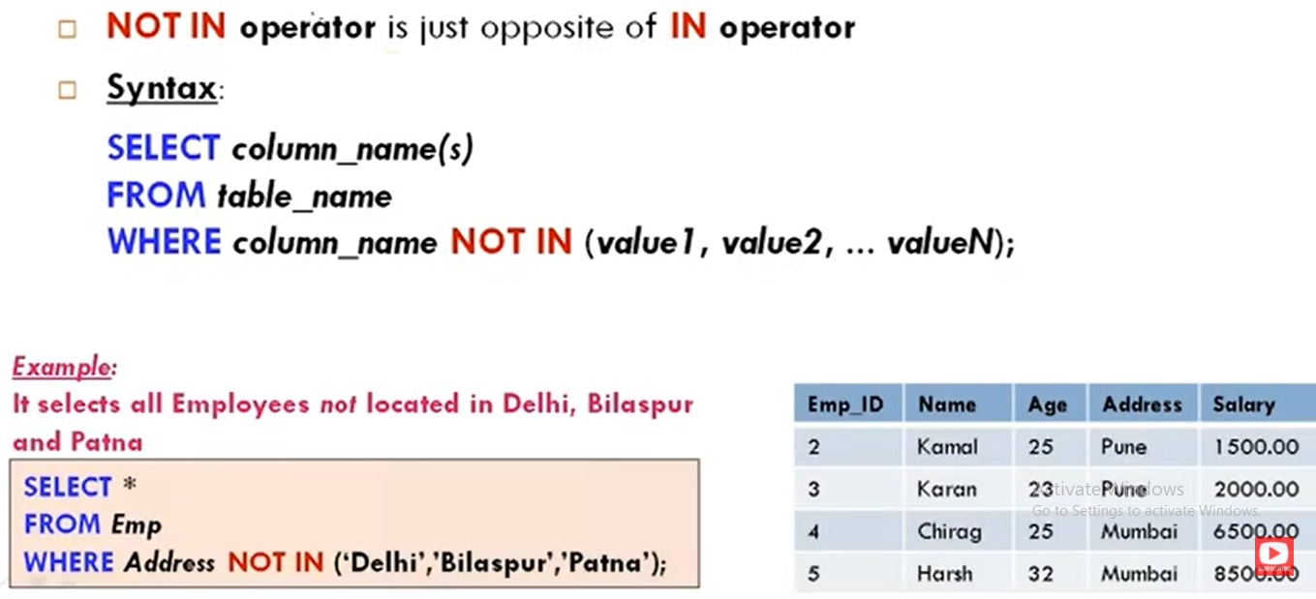
SQL : NOT IN Operator

Slide 18
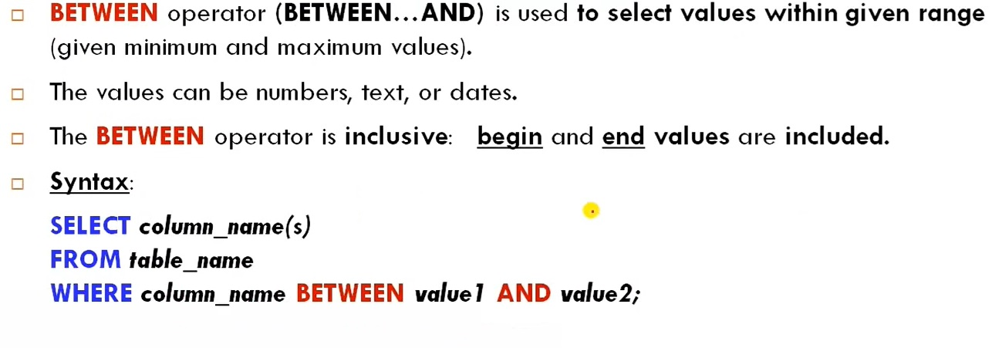
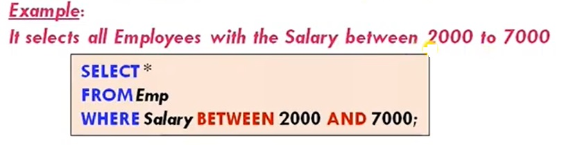
SQL : BETWEEN Operator

Slide 19
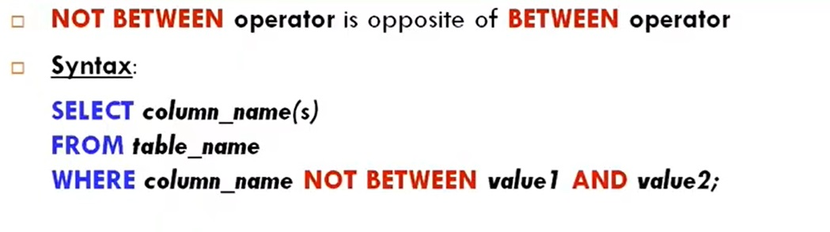
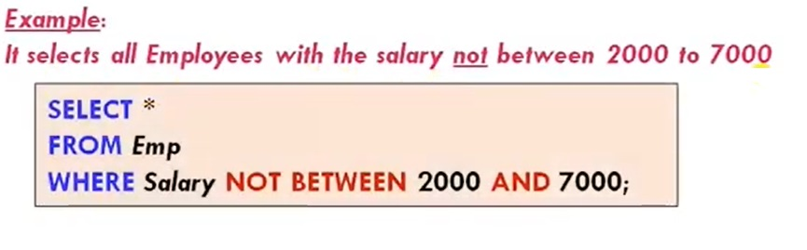
SQL : NOT BETWEEN Operator

Slide 20
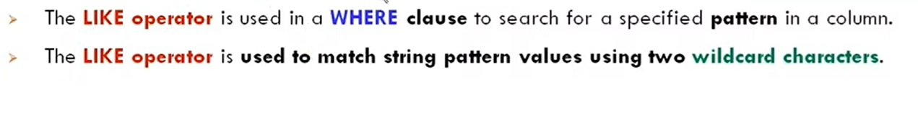
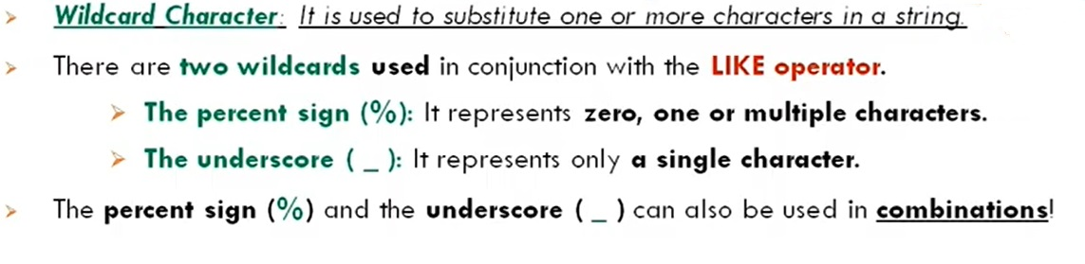
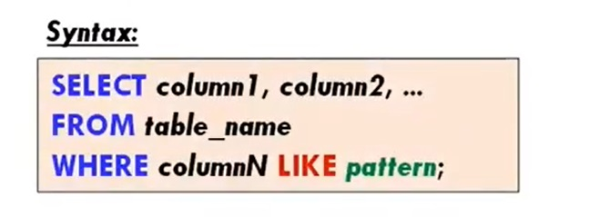
SQL : LIKE Operator

Slide 21
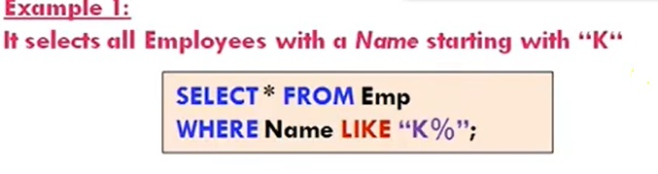
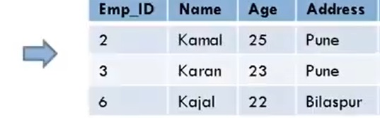
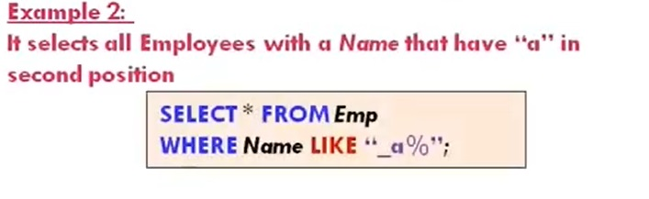
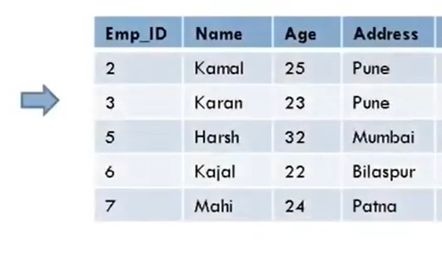
SQL : LIKE Operator (Example)

Slide 22
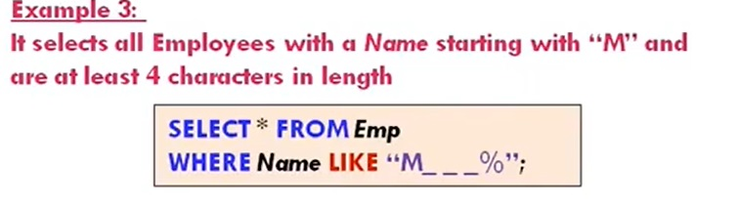
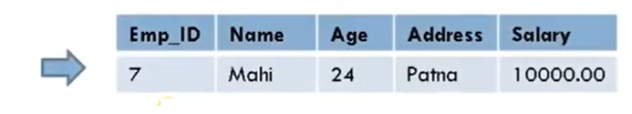
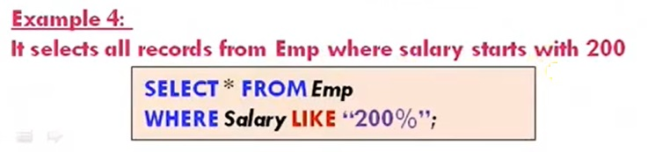
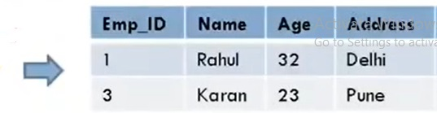
SQL : LIKE Operator (Example)

Slide 23
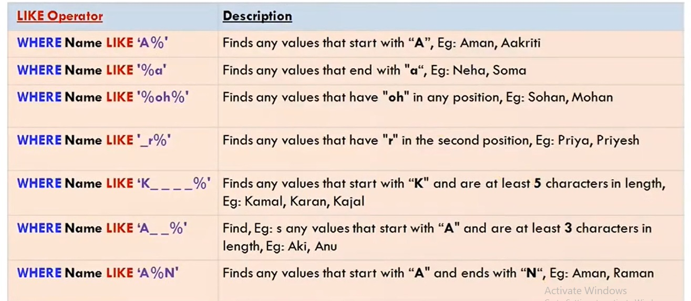
SQL : LIKE Operator with wildcard operator (%,_)

Slide 24
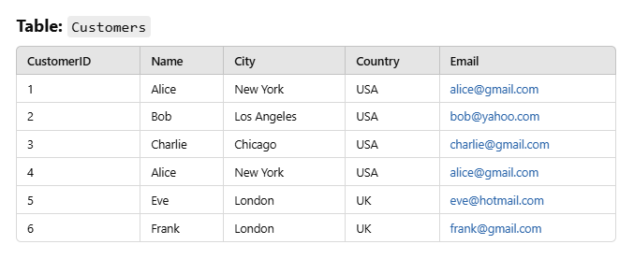
Exercise – Distinct Clause

Slide 25
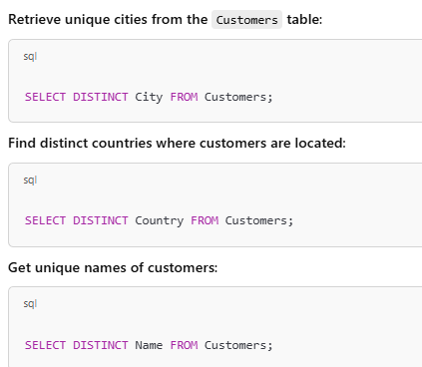
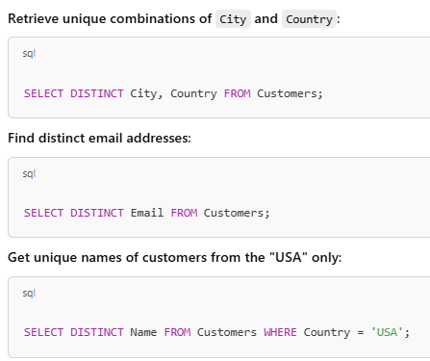
Exercise – Distinct Clause cont..

Slide 26

Exercise Table

Slide 27

Queries Using AND

Slide 28

Queries Using AND cont..
SELECT * FROM Products WHERE Category = 'Furniture' AND Price = 200 AND StockQuantity < 10;

Slide 29

Queries Using OR

Slide 30

Queries Using OR cont..

Slide 31

Queries Using NOT

Slide 32

Queries Using NOT cont..

Slide 33

Queries Using IN

Slide 34

Queries Using IN cont..

Slide 35

Queries Using NOT IN

Slide 36

Queries Using NOT IN cont..

Slide 37

Queries Using BETWEEN

Slide 38

Queries Using BETWEEN cont..

Slide 39
Thank You

